Slide 1
Editable List View Panels
November 28, 2014
Notes:
Guidewire training materials contain Guidewire proprietary information that is subject to confidentiality and non-disclosure agreements. You agree to use the information in this manual solely for the purpose of training to implement Guidewire software solutions. You also agree not to disclose the information in this manual to third parties or copy this manual without prior written consent from Guidewire. Guidewire training may be given only by Guidewire employees or certified Guidewire partners under the appropriate agreement with Guidewire.

Slide 2
  Configure a list view panel to be an editable list view panel
  Configure a list view panel so that rows can be added to and removed from it

Slide 3
Editable list view panels
Iterator buttons

Slide 4
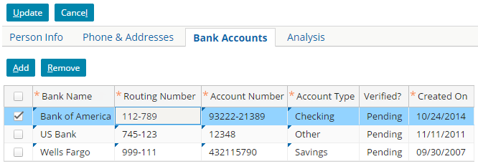
Editable list view panels
Edit Buttons
a
b
Iterator Buttons
c
Editable list view panels enable users to create new rows, remove rows, and edit existing rows
Iterator Buttons provide functionality when in list view panel container toolbar
  Add new rows with the Add iterator button
  Remove existing rows with the Remo iterator button
  Modify fields in new and existing rows
Notes:
The Iterator Buttons widget contains both buttons needed to add and remove rows. The buttons also already have the appropriate visibility logic. They are visible only when the location is in edit mode.

Slide 5
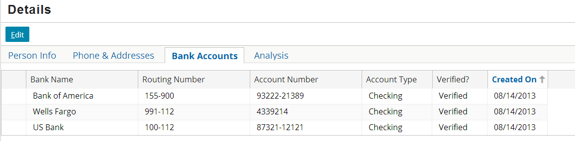
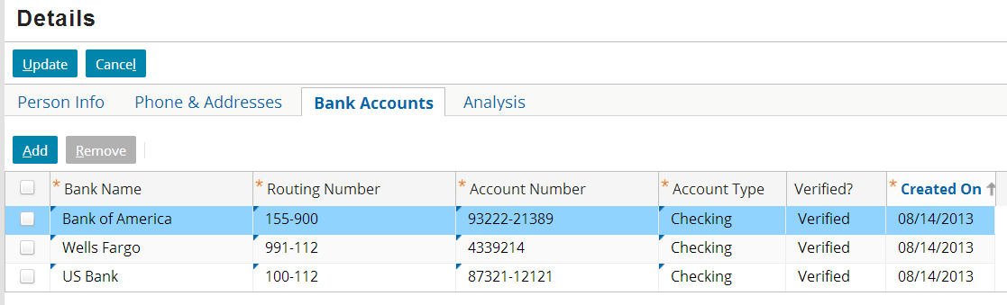
Edit mode for list view panels
Edit buttons control the screen transaction
Iterator buttons add and remove objects in list view panels
  Located in container for list view panel
  Only available when in location is in edit mode
Screen level toolbar
List view panel container toolbar
Notes:
Because the PCF architecture is hierarchical in nature, there is often more than one place that a toolbar could go. In the slide example, toolbars are visible at both the screen level and list view panel container level. Besides the screen level toolbar for edit buttons, the best place for a toolbar is the highest place in the hierarchy of containers that you want the toolbar to affect. For example, if you need the same toolbar on every card of a card view, then you will provide users with a more intuitive interface if you place a single toolbar at or above the card view level as opposed to putting individual toolbars on every card.
It is possible to set a location so that it is always in edit mode. Edit buttons are still required in the toolbar if To configure this, set the location's startInEditMode property to true and alwaysInEditMode property to true. A location that is always in edit mode has only Update and Cancel buttons—there is no Edit button. Whenever either of the buttons is clicked, the changes are committed or canceled, and the location immediately reverts to edit mode.

Slide 6
Editable hierarchy
list view panel is
editable
row iterator
is editable
row is
editable
cell is
editable
For a cell to be editable, only the row iterator needs to be explicitly set to editable
  List view panel and row can inherit editable from parent
List view panels can include editable cells and non-editable cells
  Routing Number is editable
  Created On is read-only
Notes:
The following summarizes the default value of the editable property for each element:
A list view panel's editable property is blank. The property is not required. (A list view panel with no specified editable property is editable.)
A row iterator's editable property is blank, but this property is required. To have editable cells, it must be set to true, or to a condition that evaluates to true.
A row's editable property is blank. The property is not required. (A row with no specified editable property is editable.)
A cell's editable property is false. To have the cell be editable, you must set the property to true, or to a condition that evaluates to true.
In practice, the two elements you must explicitly set to editable to get editable cells are the row iterator and the cells that are to be made editable.

Slide 7
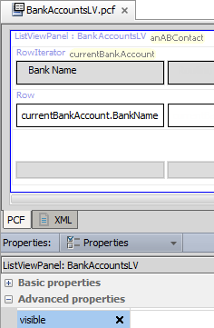
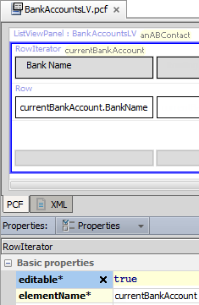
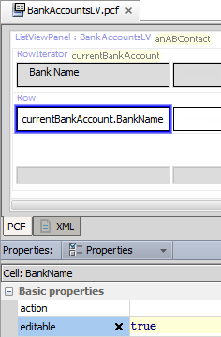
Example of explicit editable cell
List view panel editable property undefined = true
Row iterator must specify editable = true
Cell must specify editable = true
Cell widget
Row Iterator
List View Panel
Notes:
The screenshots above show the configuration within a list view panel needed to make the data in the Bank Name cells editable. Note the following about the BankAccountsLV list view panel:
The list view panel itself is editable. Editable is either blank or set to true.
The row iterator is editable.
The cell widget itself is editable.
This presumes that all container widgets that contain BankAccountsLV are also editable.

Slide 8
Editable list view panels
Iterator buttons

Slide 9
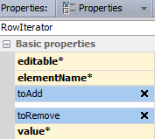
Iterator buttons and row iterators
Properties of row iterator govern functionality of
iterator buttons (Add|Remove)
  toAdd - action to take when Add is clicked
  toRemove - action to take when Remove is clicked

Slide 10
Steps to adding iterator buttons
Add iterator buttons to toolbar
Link iterator buttons to iterator
Specify toAdd property
Specify toRemove property
Configure checkbox behavior
Deploy PCFs

Slide 11
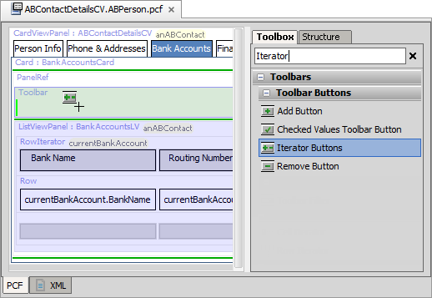

Step 1: Add iterator buttons to toolbar
To the
list view panel container
toolbar,
add the
Iterator Buttons
widget
Shows as
Add | Remove buttons in PCF Editor
Includes Add and Remove buttons
Notes:
The Iterator Buttons widget contains both buttons needed to add and remove rows. The buttons also already have the appropriate visibility logic. They are visible only when the location is in edit mode.

Slide 12

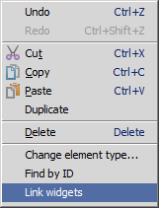

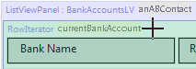
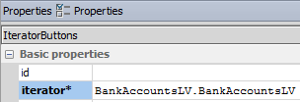
Step 2: Link iterator buttons to iterator
(1) Context menu →
Link widgets
(2) Click iterator buttons
(3) Click row iterator
(4) Set iterator property
Notes:
These steps require that you show hidden widgets.
(1) After adding the iterator buttons widget to the Toolbar, the buttons will appear red because an iterator has not been assigned. The iterator property for the iterator buttons widget is required. Select the widget and right click to open a context menu. In the menu, select Link widgets. The mouse cursor changes to a crosshair cursor. The iterator buttons widget changes to a green-red color to indicate that it is available for linking. A row in a row iterator turns green.
(2) Using the crosshair cursor, click the iterator buttons widget itself. The widget will now have a bold green border and red background. Any row iterators available for linking will be green.
(3) Click the row iterator that you want to link to directly. Even though the row widget also appears green, do not click the row. The row iterator and row will revert to their original color. The iterator buttons widget will appear as it original did when originally added to the toolbar (red with a dark purple border)
(4) Select the iterator buttons widget. In the Properties widow, set the iterator property to the list view panel. Click the SmartHelp button to display a list of exposed iterators, and select the appropriate one. The syntax seem counter intuitive, but is logical. The first part of the reference is the list view panel object itself. The second is a reference to the ExposeIterator variable which is declared on the list view panel and has the same name as the list view panel, for example, BankAccountsLV.BankAccountsLV.
A manual alternative to steps (1), (2), and (3):
In the list view panel, in the Properties window, in the Exposes tab, click the + button and select ExposeIterator in the menu to create the ExposeIterator variable. For the valueType property, specific the object type, for example, entity.BankAccount. In the widget property, specify the list view panel widget that you are exposing (the widget itself), for example, BankAccountsLV.
Although Studio identifies iterator buttons that have not been linked to a row iterator as an error, the PCF still functions at runtime. Iterator buttons that have not been configured to explicitly reference a particular iterator will implicitly reference and affect whichever row iterator appears after them physically in the page configuration.

Slide 13
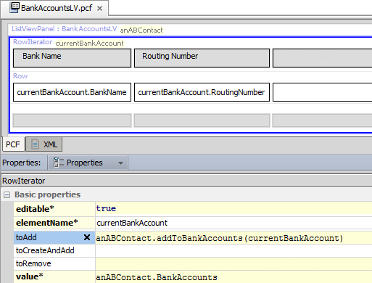
Step 3: Specify toAdd property
Syntax:
parentObj.addToarrayName(elementName)
Notes:
For every array on an entity, there are inherently two methods added to that entity:
An addTo<arrayName>() method, which adds a specified object to the named array.
A removeFrom<arrayName>() method, which removes the specified object from the named array.
The addTo... method is used to enable the functionality of the Add button.
The syntax for the toAdd property is parentObj.addToArrayName(elementName), where:
parentObj is the parent object to which the array belongs. In the slide example, the BankAccounts array belongs to the anABContact object.
ArrayName is the name of the array.
elementName is the row iterator's element name. For an Add button, this creates a new object of the appropriate type and associates it with the array.

Slide 14
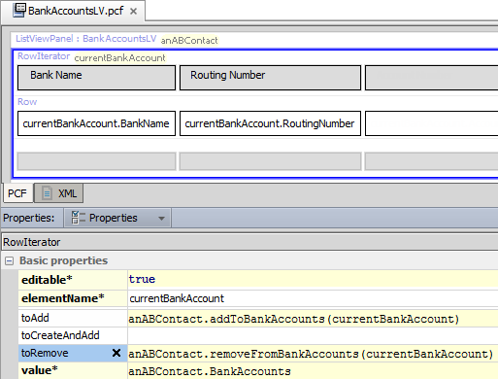
Step 4: Specify toRemove property
Syntax:
parentObj.removeFromarrayName(elementName)
Notes:
For every array on an entity, there are inherently two methods added to that entity:
An addTo<arrayName>() method, which adds a specified object to the named array.
A removeFrom<arrayName>() method, which removes the specified object from the named array.
The removeFrom... method is used to enable the functionality of the Remove button.
The syntax for the toRemove property is parentObj.removeFromArrayName(elementName), where:
parentObj is the parent object to which the array belongs. In the example above, the BankAccounts array belongs to the anABContact object.
ArrayName is the name of the array.
elementName is the row iterator's element name. For a Remove button, this removes the selected row or rows from the array.

Slide 15
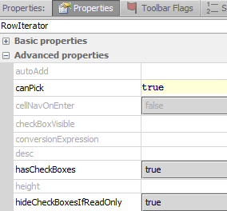
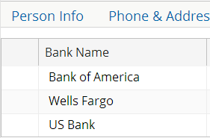
Step 5: Configure check box behavior
check boxes in
edit mode
hideCheckBoxesIfReadOnly
  Hides check boxes for read-only
check boxes in
read-only mode
Notes:
Check boxes enable the Remove button by identifying which rows to remove. hideCheckBoxesIfReadOnly hides check boxes in read-only mode.

Slide 16
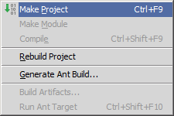
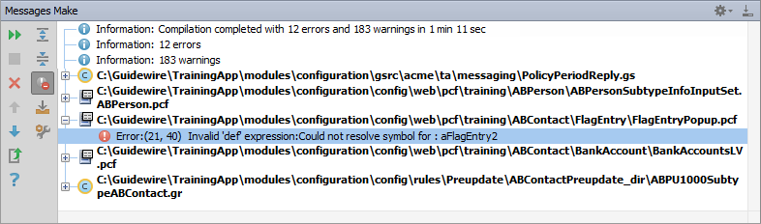
Make project to see all PCF errors
Build → Make Project
  Compiles only modified files since the last compilation
Opens Messages (Make) window for build summary
  Filter for errors
Great way to see all PCF errors
Notes:
Make Project: All the source files in the entire project that have been modified since the last compilation are compiled. Dependent source files, if appropriate, are also compiled. Additionally, the tasks tied to the compilation or make process on modified sources are performed.

Slide 17
Step 6: Deploy PCFs
Restart Server
Reload PCFs
PCFs read at server startup
ALT+SHIFT+L
  Internal debug tools enabled
Internal Tools
  Reload → Reload PCF Files
Page Configuration File
List View Panel
PCF
Page Configuration File
List View Panel
PCF
Notes:
It is also possible to reload PCF files using the Guidewire API and/or internal server tools. The Reload PCF command can be found on the Reload page in Internal Tools. To access Internal Tools, the EnableInternalDebugTools setting in the config.xml file must be set to true. The keystroke to open the Internal Tools page is ALT+SHIFT+T. In the tab bar, select Internal Tools --> Reload. On the Reload page, click the Reload PCF Files button. Both the keystroke ALT+SHIFT+L and the Reload PCF Files button call the same static method: gw.api.tools.InternalToolsUtil.reloadPCFs().

Slide 18
  Configure a list view panel to be an editable list view panel
  Configure a list view panel so that rows can be added to and removed from it

Slide 19
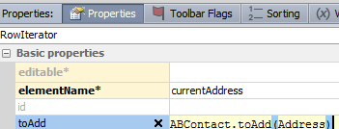
For a cell to be editable, the cell’s Editable property must be set to true. What other elements, if any, must also be editable to make the cell editable in the user interface?
When you drag an IteratorButtons widget onto a toolbar, how many buttons are added?
Assume that an object
called anABContact
has an Addresses array
and an Addresses list
view panel whose
row iterator
is configured as shown.
Identify the errors in how the property is configured.
Notes:
Answers
1) The list view panel's row iterator editable property must be set to true.
2) Two: an Add and a Remove button.
3) There are four errors: (a) The object is anABContact, not ABContact. (b) The method name starts with "addTo...", not "toAdd...". (c) The name of the array is missing from the end of the method name. (The method should be addToAddresses.) (d) The argument must reference the row iterator's element name, which is currentAddress.

